Slide 1
An algorithm for Euclidean
Travelling Salesman Problem
BTP Seminar Report
Submitted By:
Praagy Rastogi
17CS30026
Under the Guidance of
Dr. Sudeshna Kolay
Asst. Professor, Dept. of CSE IIT Kharagpur

Slide 2
Problem Domain
And Description.
Problem: Given a complete undirected graph with positive edge weights, the goal is to compute a minimum-weight cycle visiting every node exactly once where the input is a set of points in R^{d} .
It has been shown that no 2^{O(n^(1-1/d-𝜀))} algorithm exists unless Exponential Time Hypothesis fails.
A polynomial-time approximation algorithm has been found for the Euclidean TSP.
The paper An ETH-Tight Exact Algorithm for Euclidean TSP, gives a 2^{O(n^(1-1/d))} algorithm which is explained ahead and to implement which is the goal of this project to be able to better analyse it and address some issues.

Slide 3
But first a straightforward Dynamic Programming Solution ...
For a graph with n nodes consider the subproblem:
P(S,i) = Minimum weighted path from node 1 to i such that it passes through all the nodes in subset S exactly once.(Nodes 1 and i are included in S)
Answer of larger subsets is found from smaller subproblems in a bottom-up manner.
Since there are 2^{n} subsets, there are in total O(n*2^{n}) states and each state requires transition from O(n) smaller states leading to a time complexity of O(n²*2^{n}).
This works independent of number of dimensions of the input graph and is valid for the general TSP problem.

Slide 4
The Algorithm
Dividing into Subproblems
The idea is to divide our problem into smaller subproblems in such a way that we can solve them efficiently i.e. we don’t want to consider too many subproblems.
To divide the set of given points we choose a geometric separator, a hypercube.
Packing Property provides us with a powerful observation that, in an optimal tour, there cannot be too many long edges that are relatively close together.
We use this property to ensure that we don’t have too many crossing edges once we choose a separator.
We achieve this by constructing a roughly balanced separator such that there are only few points relatively close to it.
There exists an optimal tour such that the separator constructed in this way is crossed by only O(n^{(1-1/d)}) edges.

Slide 5
Steps
Find the smallest axis-aligned separator 𝞼 with n*(1-𝛅) points inside it (where n is the size of the current subset of points). For 2D case, this can be done by considering every square passing through any 3 points and then finding number of points lying inside it using prefix sums in n³.
There exists a t ∊ [1,3] such that the scaled separator 𝞼t has the desired properties.
We define a weight function w_{p}(t) for each point p such that given a t, weight increases the closer the point p is to 𝞼t .
We make each w_{p} bounded by truncating it suitably.
Each w_{p}(t) is a step function with O(log n) steps, this is because of the way it’s defined. We compute all such step points for all the points in n*log(n).
We find a t_{min} that minimizes summation of w_{p}(t) for all p. It is sufficient to check this summation for all the step points found above, which can be done easily in n²*log(n).

Slide 6
Solving Subproblems
Recursively
We have constructed a separator which has only O(n^{(1-1/d)}) crossing edges. The number of subsets of these edges we need to consider to include in an optimal tour is 2^{O(n^(1-1/d))} .
While considering a set of crossing edges, their endpoints, called boundary points B, need to be connected through a path of points to another boundary point and our goal is to find such a perfect matching on B such that sum of weight of these paths is minimum.
For 2D case, we can consider all crossing-free matchings of which there are only 2^{O(|B|)}. For higher dimensions however, we need a rank based approach.

Slide 7
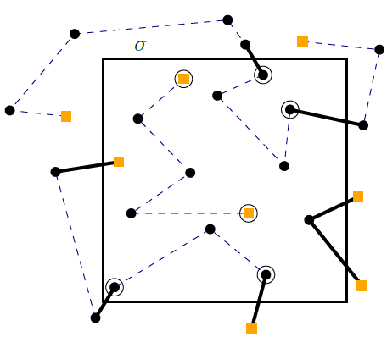
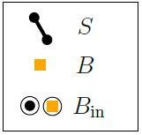
Solving Subproblem (P,B,M)
Given point set P, boundary points set B and optimal perfect matching M on B. We solve this recursively by finding a separator 𝞼 for P dividing P to P_{in} and P_{out}. |B| should be even for M to exist.
Choosing 𝞼 already fixes the sets P_{in} and B_{in} and now we can consider all perfect non-crossing matchings M_{in} (for 2D case) for B_{in} allowing us to solve this smaller subproblem and similarly for P_{out}.
Points like a and b already have the required edges and won’t be included in P_{in}.
Points like c and d are newly formed boundary points to be included in B_{in}.
Points like e and f are part of previously formed boundary points from B which are also included in B_{in}
e
a
f
b
c
d

Slide 8
Final Notes
To solve for dimensions ≥ 3 rank based method needs to be employed. The rank-based method provides a general approach for speeding up straightforward dynamic programming formulations by identifying "small" sets of representative partial solutions and expressing connectivity by sets of partitions or “bags”.
In the almost-Euclidean version of the problem the input points can have any rational coordinates. The algorithm works in this setting too but given that the ordering of pairwise distances of input points is preserved i.e. while calculating the Distance matrix the ordering of points by their pairwise distances might flip.
In conclusion we have an exact algorithm for Euclidean TSP using a geometric separator based on
Divide & Conquer method whose time complexity is 2^{O(n^(1-1/d))} and no lower complexity algorithm exists unless ETH fails.

Slide 9
References-
An ETH-Tight Exact Algorithm for Euclidean TSP
Mark de Berg, Hans L. Bodlaender, Sándor Kisfaludi-Bak, Sudeshna Kolay, arXiv:1807.06933, 2018.
Deterministic single exponential time algorithms for connectivity problems parameterized by treewidth.
Bodlaender et al , 243:86–111, 2015.
A dynamic programming approach to sequencing problems.
Held and Karp , 1962.

Slide 10
Thank You

